Slide 1



SIMATS ENGINEERING
Data Structure Selection for Real-World Applications
CSA 0303 – Data Structures
CO1 – AT2- TECHNICAL PRESENTATION
Presented by:
M Rumana Khan (192471025)
Guided by:
Dr. T. Rajesh Kumar

Slide 2

TOPIC 1: Music Streaming Playlist
Problem Statement
Scenario :
A music streaming application maintains a playlist.
Users can:
Add songs
Remove songs
Reorder songs
Move to next/previous song
Challenge
Playlist changes happen frequently.
Operations should be fast without shifting large amounts of data.

Slide 3
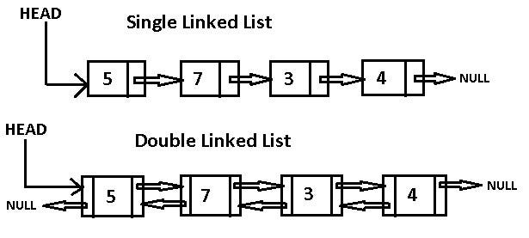
Recommended Data Structure
Doubly Linked List :
A Doubly Linked List stores each song as a node containing:
Song information
Pointer to previous song
Pointer to next song
Why Doubly Linked List?
Efficient insertion
Efficient deletion
Easy forward and backward navigation
Supports playlist reordering

Slide 4
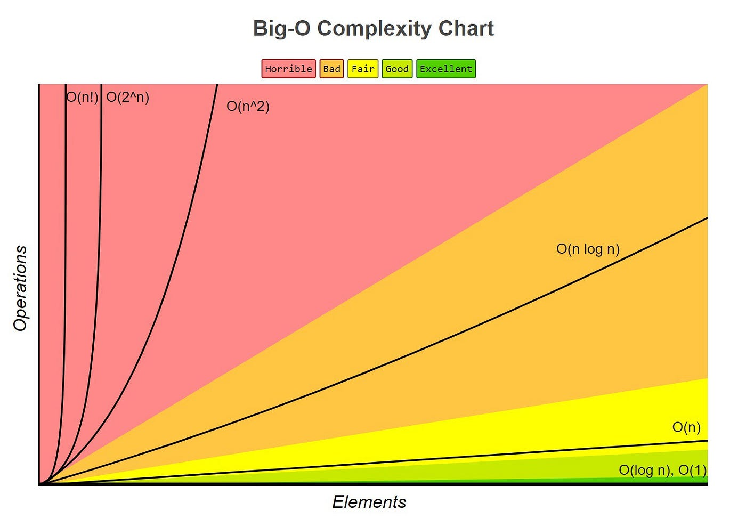
Working & Time Complexity
Working :
Every song is linked to both its previous and next song.
Adding or deleting a song only requires updating the pointers.
No shifting of other songs is needed.
Performance :
Insert Song → O(1)
Delete Song → O(1)
Move to Next/Previous Song → O(1)
Search Song → O(n)

Slide 5
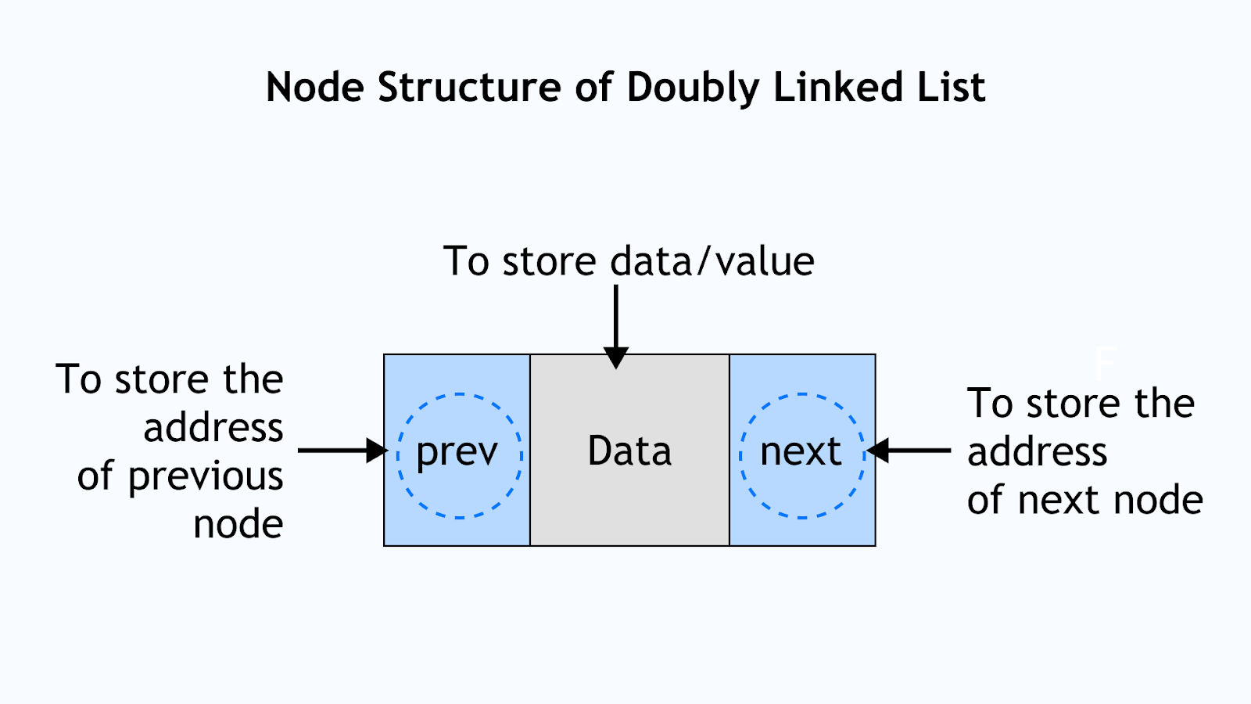
Advantages
Compared to arrays, a Doubly Linked List:
Does not require shifting elements during insertion or deletion.
Can grow or shrink dynamically.
Supports quick playlist editing.
Allows smooth next and previous navigation.

Slide 6

Conclusion
Recommended Data Structure: Doubly Linked List.
Justification :
Best suited for dynamic playlists.
Provides efficient insertion, deletion, and reordering.
Ensures smooth navigation between songs.
Real-world Example : Spotify, Apple Music, and VLC Media Player use linked structures for playlist navigation.

Slide 7
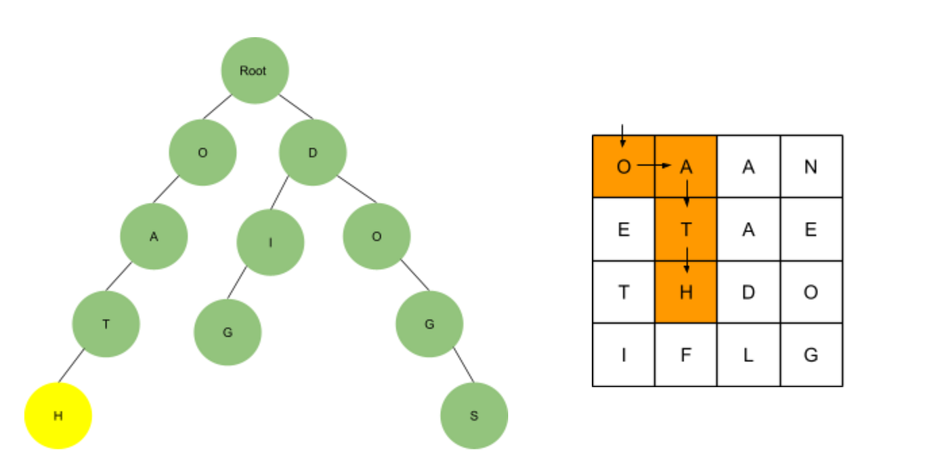
TOPIC 2: Dictionary Word Search
Problem Statement
Scenario :
A dictionary application stores millions of words and needs to determine whether a word exists in the database.
Requirements
Extremely fast word lookup
Efficient insertion of new words
Easy deletion of obsolete words
Ability to handle a very large dataset
Challenge
Searching each word one by one (Linear Search) is inefficient because it requires O(n) time.

Slide 8
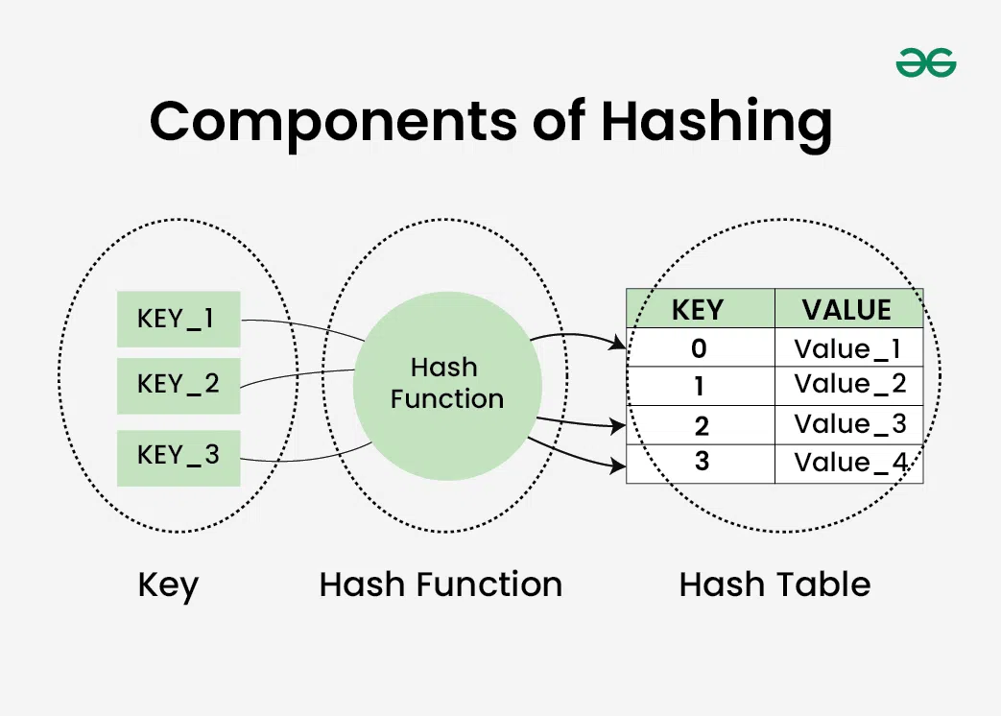
Recommended Data Structure
Hash Table :
A Hash Table is a data structure that stores data as key-value pairs and uses a hash function to calculate the storage location (index) of each word.
Working :
The input word is passed through a hash function.
The hash function generates an index.
The word is stored at that index in the hash table.
During searching, the same hash function is applied to directly access the required location.

Slide 9
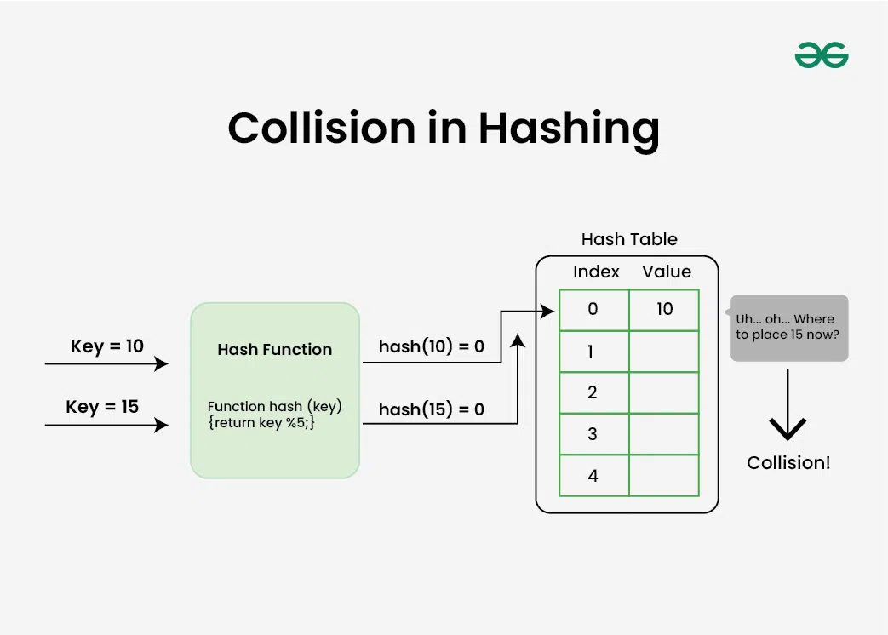
Working & Time Complexity
Time Complexity :
Search: O(1) (Average)
Insert: O(1) (Average)
Delete: O(1) (Average)
Worst Case: O(n) (due to collisions)
Advantages :
Fast lookup
Efficient updates
Suitable for large databases

Slide 10
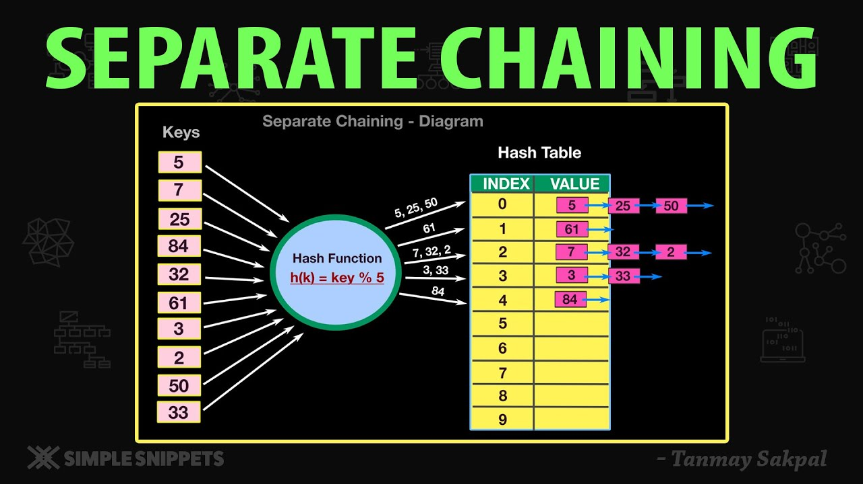
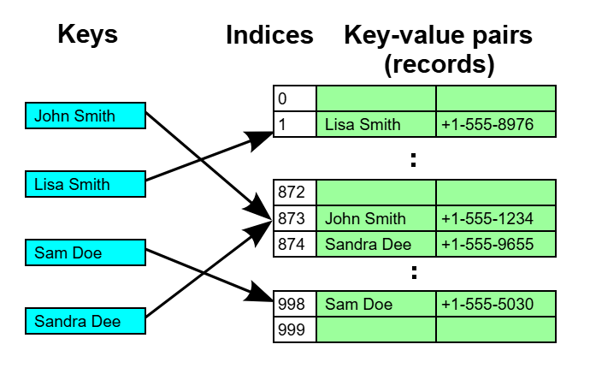
Why Hash Table?
Collision Handling
Separate Chaining: Store collided words in a linked list.
Open Addressing: Find another available index.
Why Choose It?
Faster than arrays and linked lists.
Better than BSTs for exact-word search.
Simpler and more memory-efficient than Tries when prefix search isn't needed.

Slide 11
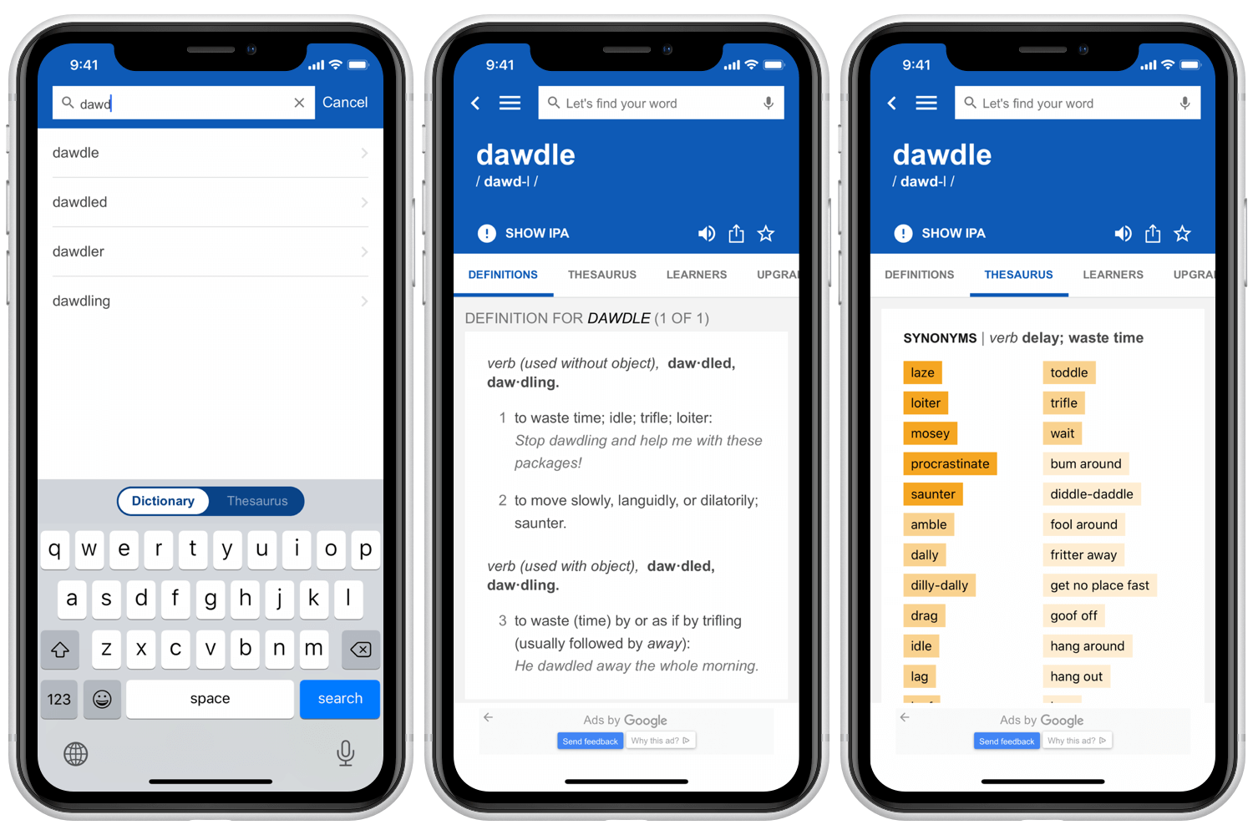
Conclusion
Recommended Data Structure: Hash Table.
Justification :
Provides O(1) average search time.
Handles large datasets efficiently.
Best suited for exact word lookup.
Real-world Example : Dictionary Apps, Spell Checkers, Password Verification, Database Indexing.

Slide 12
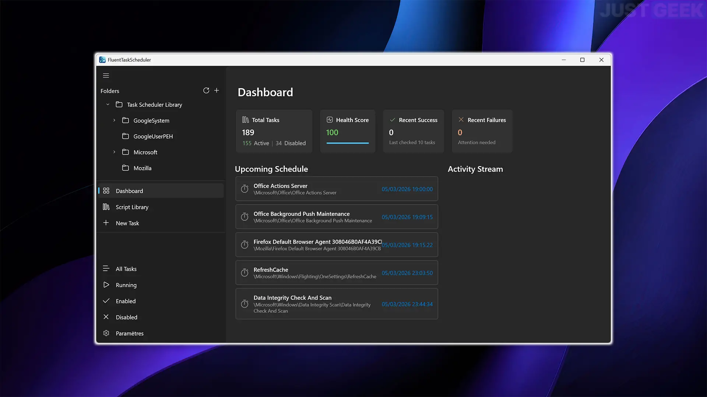
TOPIC 3: Task Scheduling System
Problem Statement
Scenario :
A task scheduler executes jobs based on their priority rather than the order in which they arrive.
Requirements
Execute the highest-priority task first.
Insert new tasks efficiently.
Remove completed tasks quickly.
Challenge
Maintain the correct priority order while handling dynamic task arrivals.

Slide 13
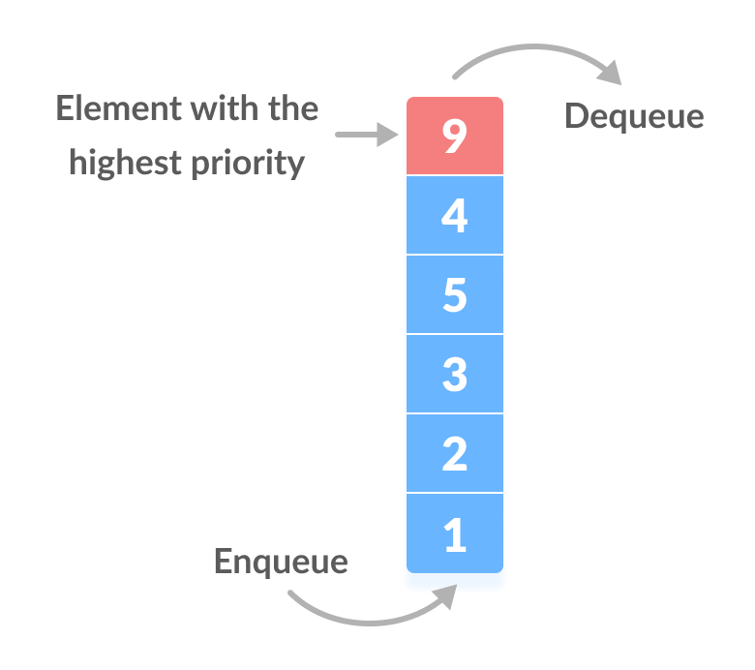
Recommended Data Structure
Priority Queue (Binary Heap) :
A Priority Queue is a data structure where each task is assigned a priority, and the task with the highest priority is processed first.
Working :
New tasks are inserted into the Binary Heap.
The heap automatically reorganizes to maintain the priority order.
The highest-priority task is always stored at the root and executed first.
Benefit: Provides efficient scheduling without sorting the entire task list after every insertion.

Slide 14
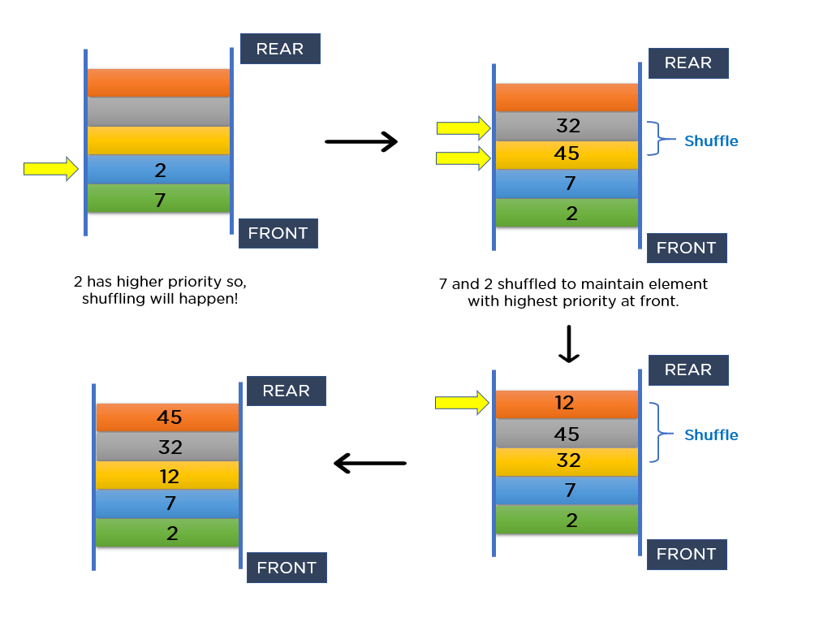
Working & Time Complexity
Time Complexity :
Insert Task → O(log n)
Remove Highest Priority → O(log n)
Peek Highest Priority → O(1)
Advantages :
Fast retrieval of the highest-priority task.
Efficient insertion and deletion.
Maintains task priorities automatically.
Performs well even when tasks are frequently added or removed.

Slide 15
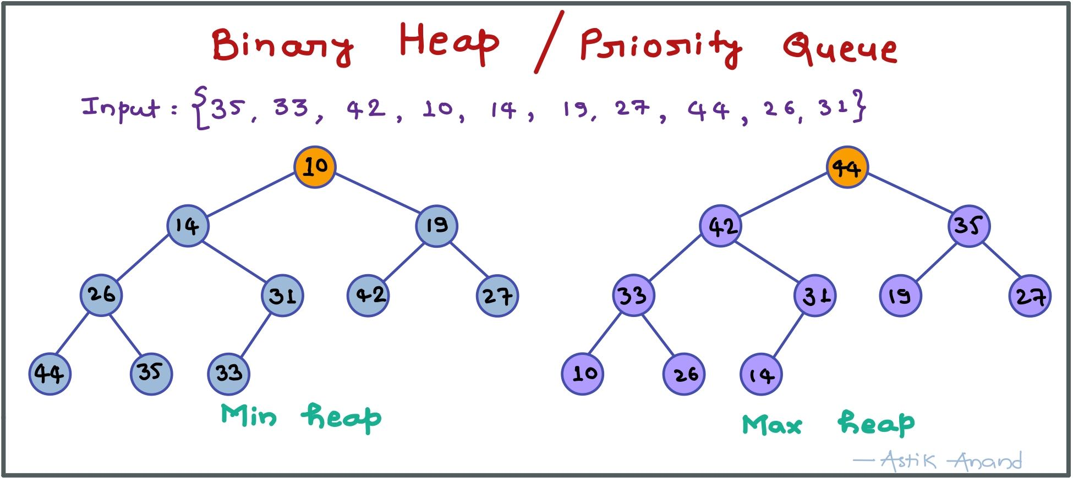
Why Priority Queue ?
Why Not a Normal Queue?
A normal queue follows the First-In, First-Out (FIFO) principle.
A Priority Queue executes tasks based on their importance rather than arrival time.
Why Binary Heap?
Maintains priority efficiently.
Requires less memory than many alternative implementations.
Delivers balanced performance for insertion and deletion operations.

Slide 16
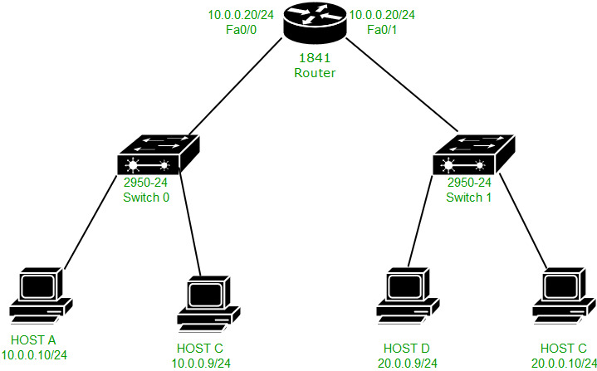
Conclusion
Recommendation: Priority Queue (Binary Heap)
Justification
Always executes the highest-priority task first.
Provides efficient task management with O(log n) insertion and deletion.
Suitable for systems where priorities change dynamically.
Real-World Applications
CPU Process Scheduling
Printer Job Scheduling
Hospital Emergency Systems
Network Packet Routing
Event-Driven Simulations

Slide 17


